Slide 1
Interaction patters with multiple views
Use interactions when there are more stories to tell in a dataset than can be displayed at one time
Use interaction when it allows the user to clarify or focus on a particular thing
Use interaction when it allows more precision than is otherwise possible
Don’t use interaction just to make something flashier!

Slide 2
Select
Useful for getting more information about a particular point or region, especially exact values.
Not useful for comparison between values
Hover (tooltip): http://bl.ocks.org/d3noob/a22c42db65eb00d4e369
Brushing: https://bl.ocks.org/mbostock/4063663
Be careful of:
Click targets need to be big enough to be usable
The user shouldn’t have to click every point — if they do, it’s not visualization!

Slide 3
Pan & zoom
Useful when the data is interesting on many scales:
Example: stock market: http://sta.mn/rsj
Example: mapping: http://maps.stamen.com/terrain/#15/32.7493/-97.3324

Slide 4
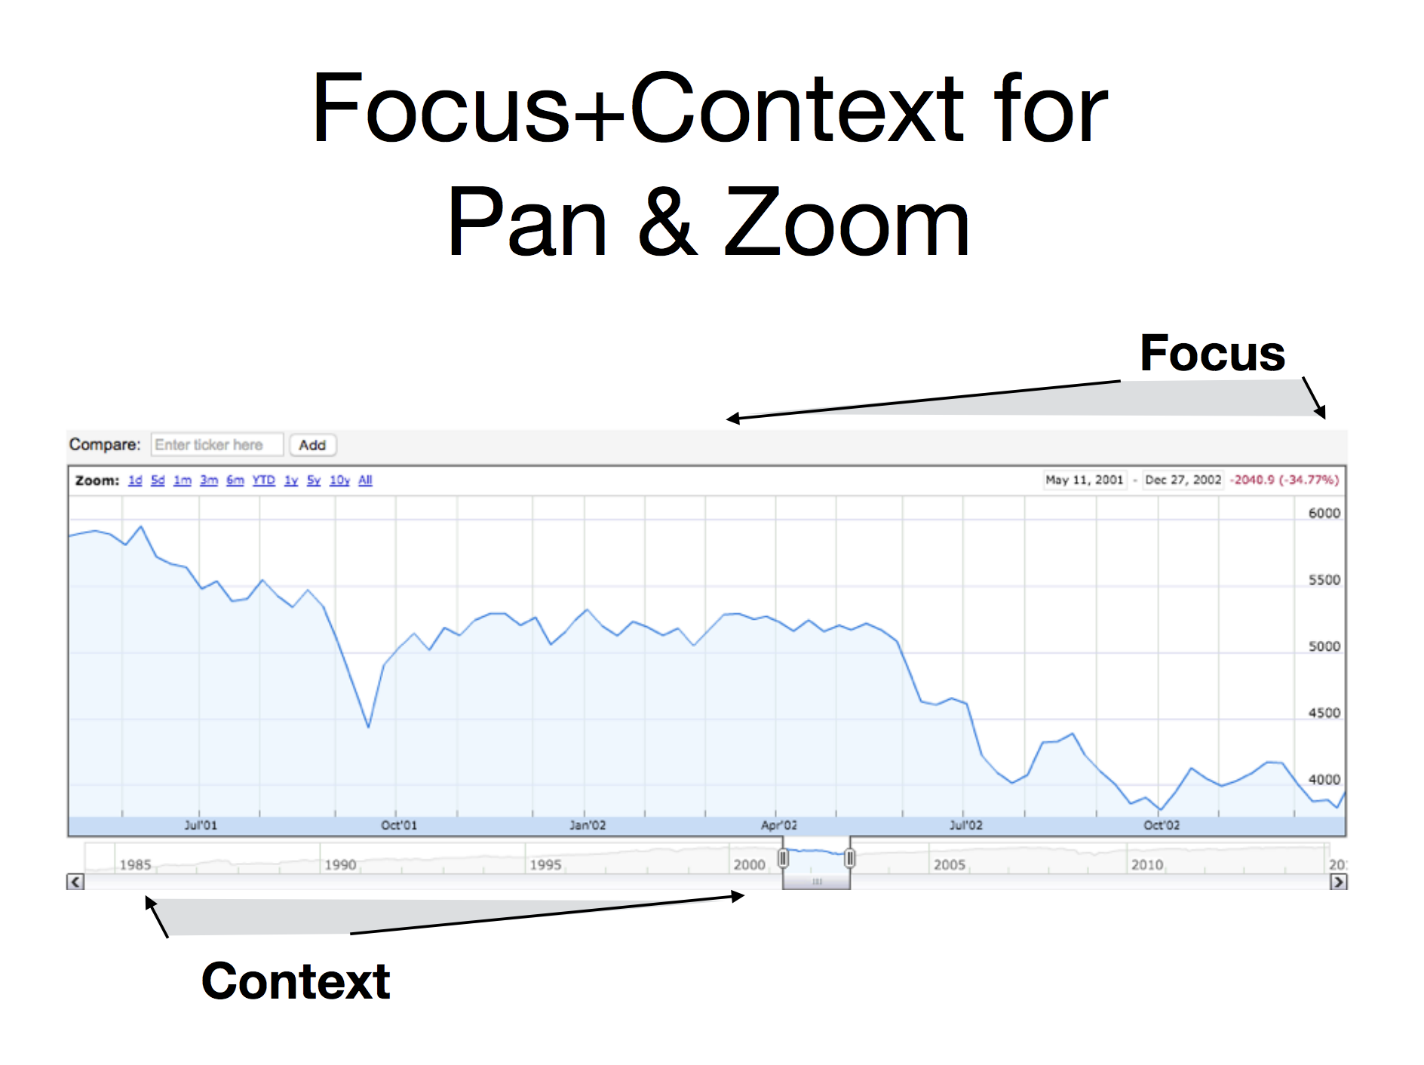

Slide 5
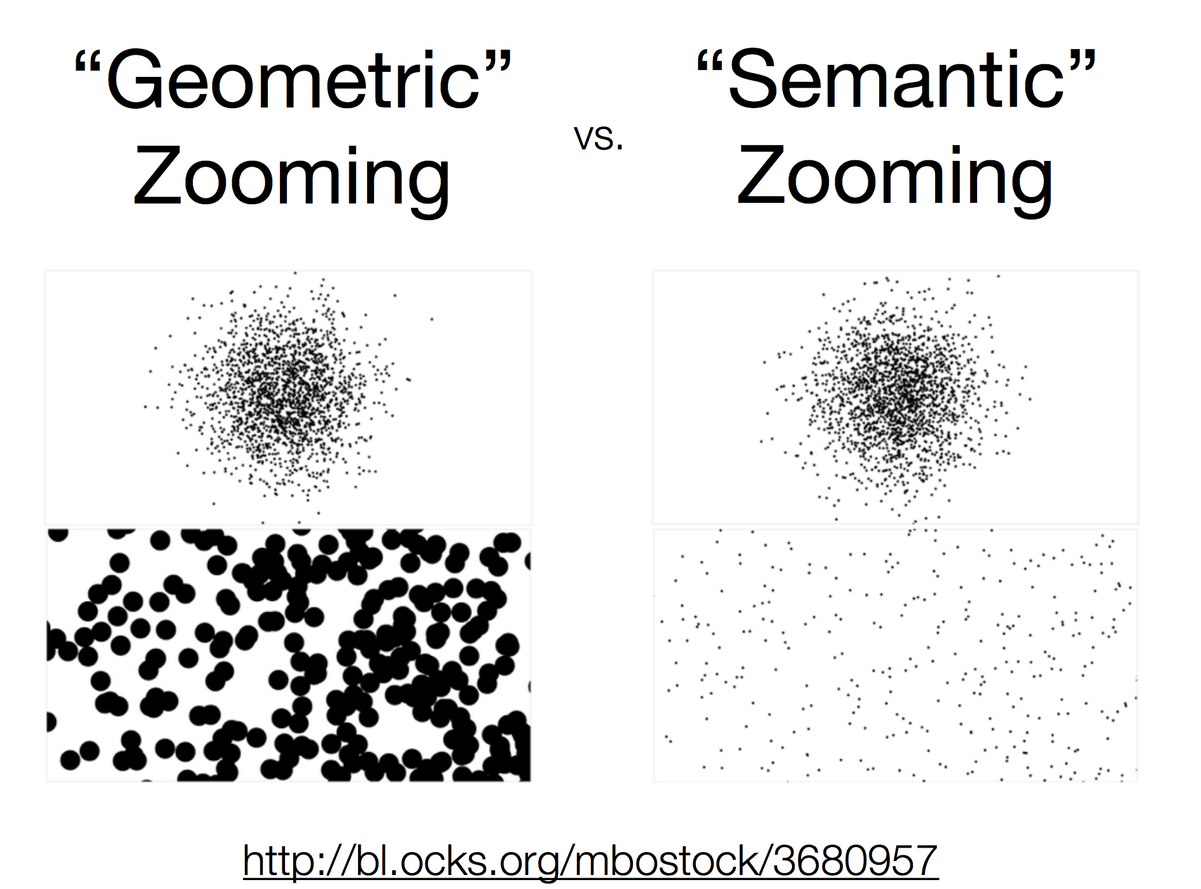

Slide 6
Filter: displaying a subset of items, selected by category or attribute
Example:
Be careful of:
Information overload! Too many filter options can make a confusing experience

Slide 7
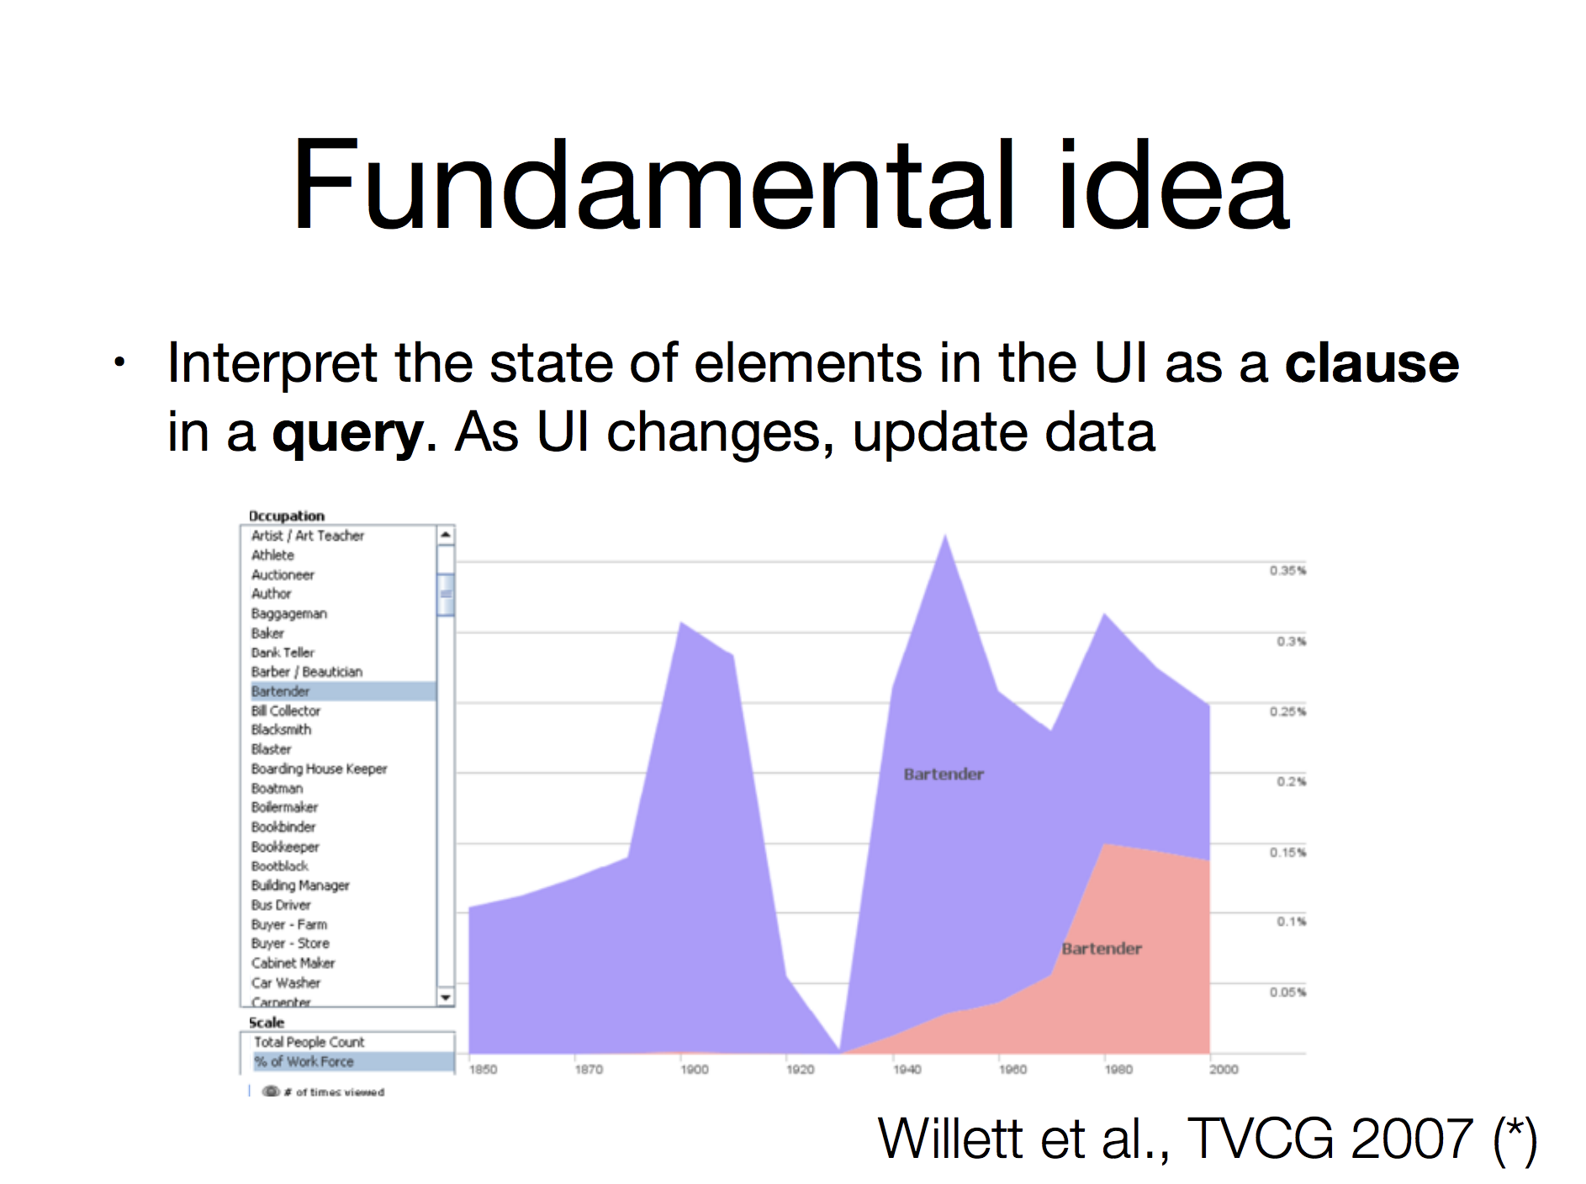

Slide 8
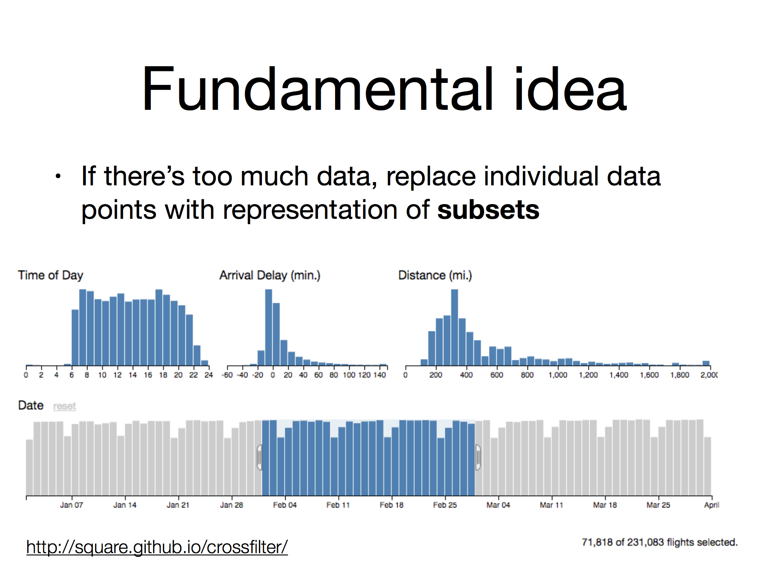
Aggregation
Notes:
http://square.github.io/crossfilter/

Slide 9
Constrained/guided interaction (scrollytelling)
People frequently don’t ever interact with interactive visualizations
Scrolly-telling constrains the interaction to guide the user through the data visualization
Became popular starting around 2012 with the New York Times

Slide 10
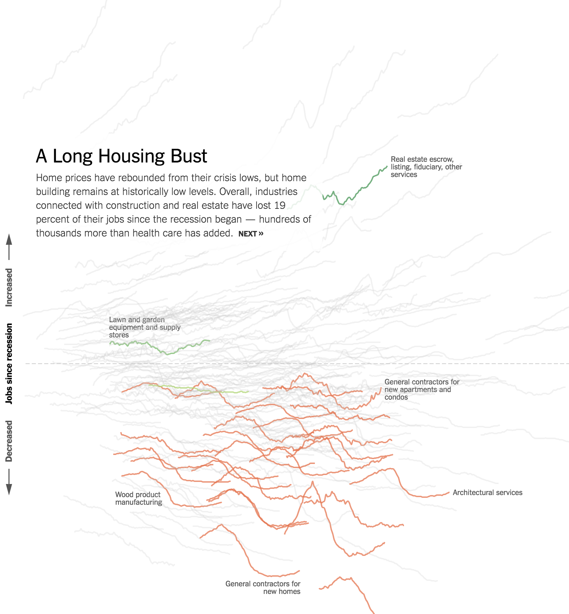
https://www.nytimes.com/interactive/2014/06/05/upshot/how-the-recession-reshaped-the-economy-in-255-charts.html??mtrref=undefined

Slide 11
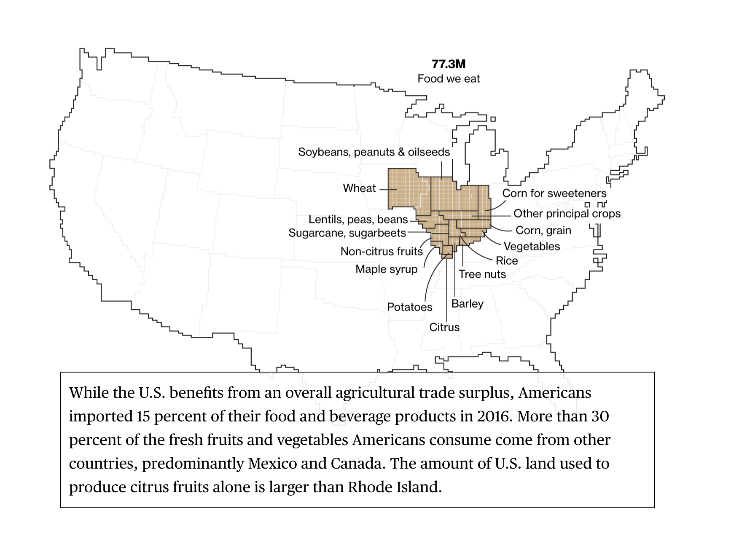
https://www.bloomberg.com/graphics/2018-us-land-use/?

Slide 12
Interactive Visualization Examples
Linked Line Chart & Choropleth
Scatter Plot with Menus
Linked Scatter Plot & Bar Chart
World Countries Hierarchy
Cities on the Globe
Religions of Largest 20 Countries
Crossfilter
StreamGraph Explorer
Campaign Finance Map & Grid
Mortality Linked Tree & Stacked Area
Migrant Deaths over Time

Slide 13
Organizing multi-view projects
Encapsulation and abstraction
Single state store
Render — interact update model
Other libraries for handling state

Slide 14
“Unidirectional” Data Flow
change state
event listener
render
interact
general update pattern
perception & cognition
volition & action

